Slide 1
Using Doc2Vec for Automated Content Curation
Presented by Chuong Ngo

Slide 2
Thirteenth Labour of Heracles
Thermodynamics Research Center
Provides source data to researchers/industry
Accelerates background research; greater productivity
Manual review of literature
Determine relevance & extract key ideas
Very labor intensive
Literature sources growing rapidly

Slide 3
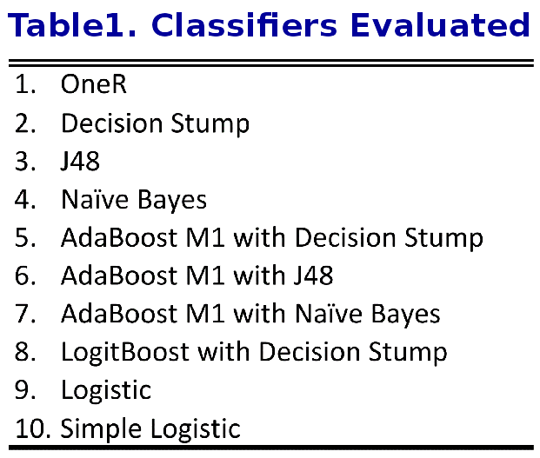
The Road Just Traveled
2 topic models
LDA & LSI
2 corpus sizes
728 & 2357
10 classifiers

Slide 4
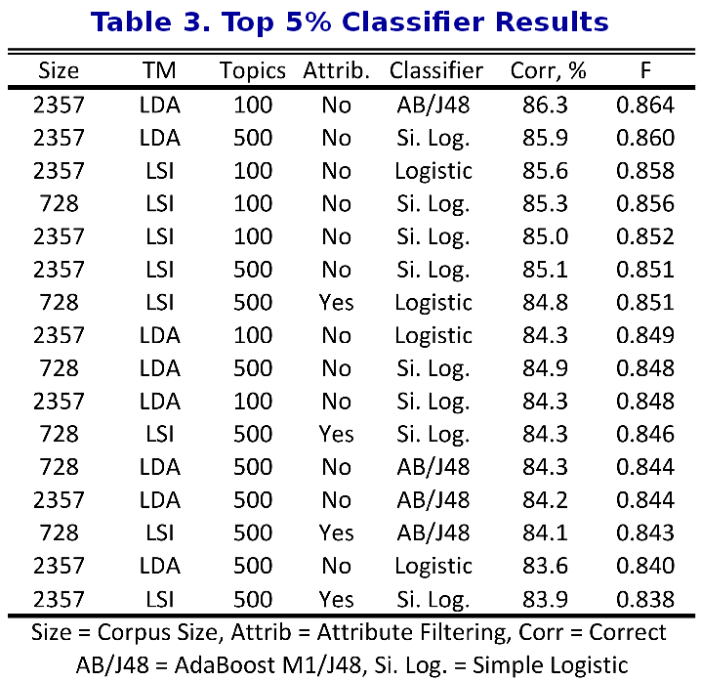
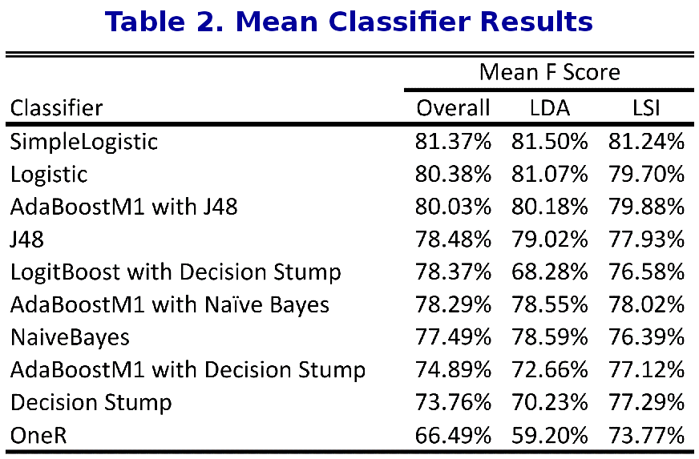
The Road Just Traveled

Slide 5

Background

Slide 6
Word2Vec
Produces vector representations of corpus
Two-layer neural network: shallow learning
Skip-gram with negative sampling (SGNS)
Continuous bag of words (CBoW)
Semantic/syntactic relationships represented by distance

Slide 7
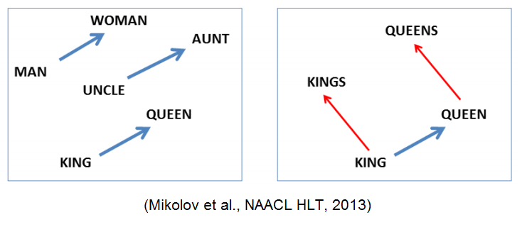
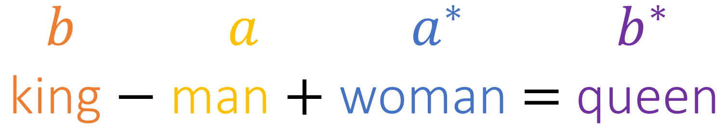
Word2Vec

Slide 8
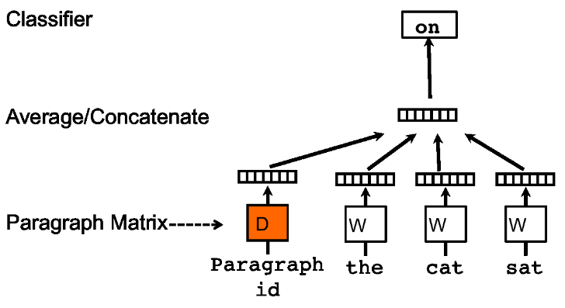
Doc2Vec
Word2Vec w/ labeled token groups
Relationships built b/t tokens and labels

Slide 9

Methodology

Slide 10
Methodology Overview
Corpus pre-processing
Train doc2vec model
Extract document vectors from model
Tag w/ ground truth, interesting or not interesting)
Train classifier with extracted vectors
Test the accuracy of the classifiers

Slide 11
Corpus Pre-processing
NLTK-based pre-processor
RegEx tokenizer
Porter stemmer
Stopword removal
Alternative techniques
Lemmatizer instead of stemmer
Removal of irrelevant identifiers (e.g. email addresses)
Removal of numbers

Slide 12
Train Model & Label Doc Vectors
Gensim Implementation
Number of features: 300 & 500
Negative samples: 0, 5, 10, 20
Minimum count: 1
Retrieve vector for each document in corpus from model
Label with ground truth data

Slide 13
Train Classifiers and Test
Use WEKA implementations
11 Classifiers: 10 previously seen and Random Forest
Tests using cross-validation and prediction

Slide 14
Train Classifiers and Test
Use WEKA implementations
11 Classifiers: 10 previously seen and Random Forest
Test classifiers for accuracies
Cross-validation & prediction
Prediction uses average word vectors of all tokens and unique tokens

Slide 15

Results

Slide 16
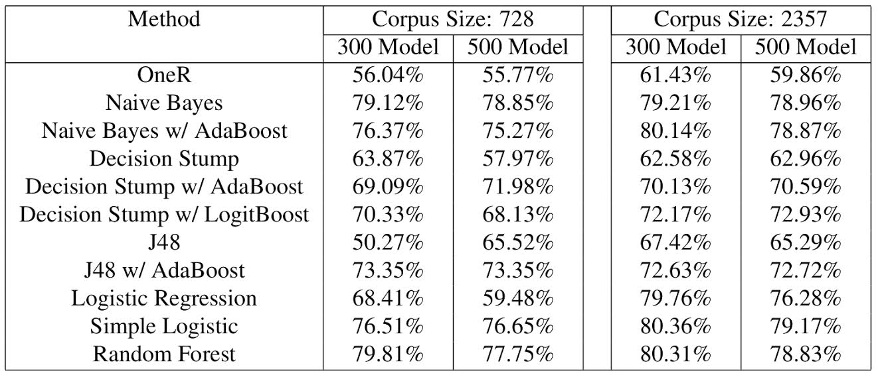
Cross-validation Accuracies

Slide 17
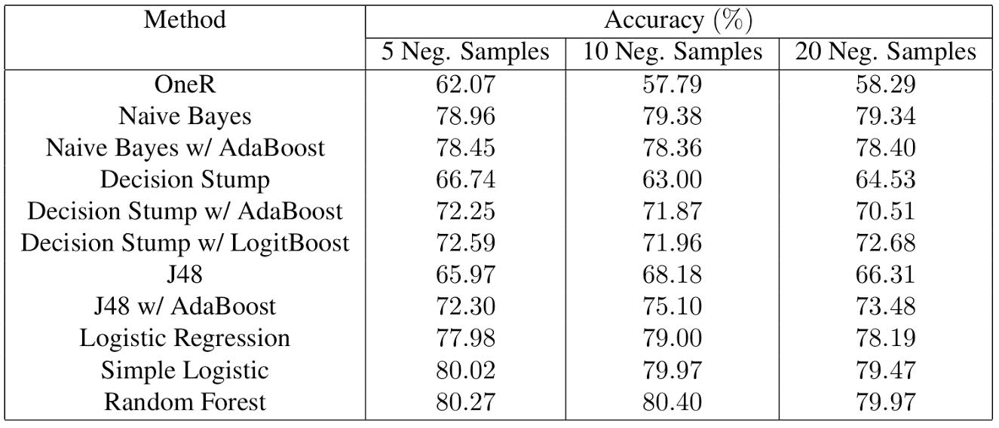
Cross-validation w/ Negative Samples

Slide 18
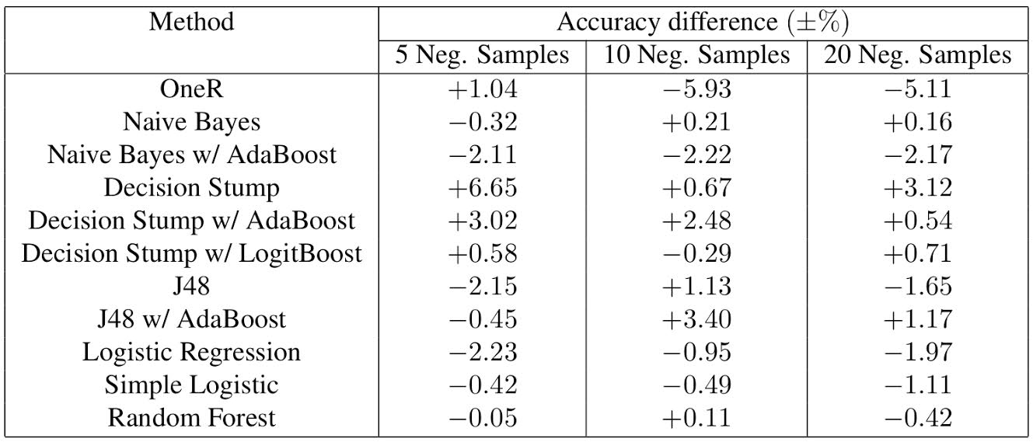
Cross-validation w/ Negative Samples

Slide 19
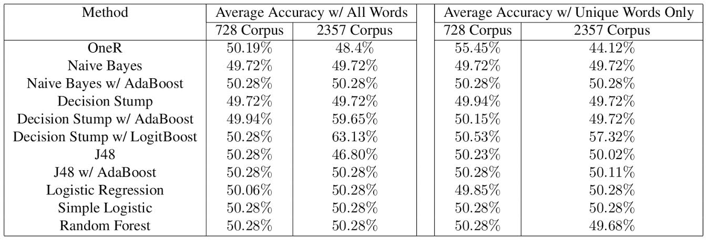
Prediction Accuracies

Slide 20
Summary
Utility of Doc2Vec questionable
Impact of negative sampling inconclusive
Doc2Vec presents a challenge when dealing with new documents

Slide 21

Questions?

